Slide 1
WELCOME
TO
FOODZ
Online food ordering system

Slide 2

PRESENTED BY
ANSHUL SANGHI
2018BCS-009
DEEP SHAH
2018BCS-052
SHIVANSH SRIVASTAV
2018BCS-053

Slide 3
INTRODUCTION
There is a lot of scope online food ordering business and we can tap it to the max extent possible as everyone has access to an online ordering facility via the internet. Food business usually will have high demand and hence online business prospect for food ordering should be profitable. We will provide an easily accessible interface wherein the customer can view and place the order easily.

Slide 4
USERS OF THE SYSTEM
The users of the system include the customers and the employees. The employees of the system are responsible for updating the menu items as well as the delivery of the item to a particular address. The customers will visit the website, check for the items available in the menu, order for one or more items in the menu. All the activities such as ordering items online, delivery of the items by employees, the vehicle used to deliver the items etc. will be recorded in the database for all the events.

Slide 5
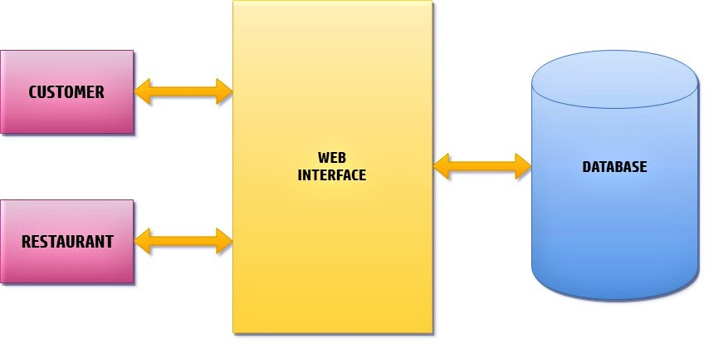
THE ARCHITECTURE OF THE APPLICATION

Slide 6
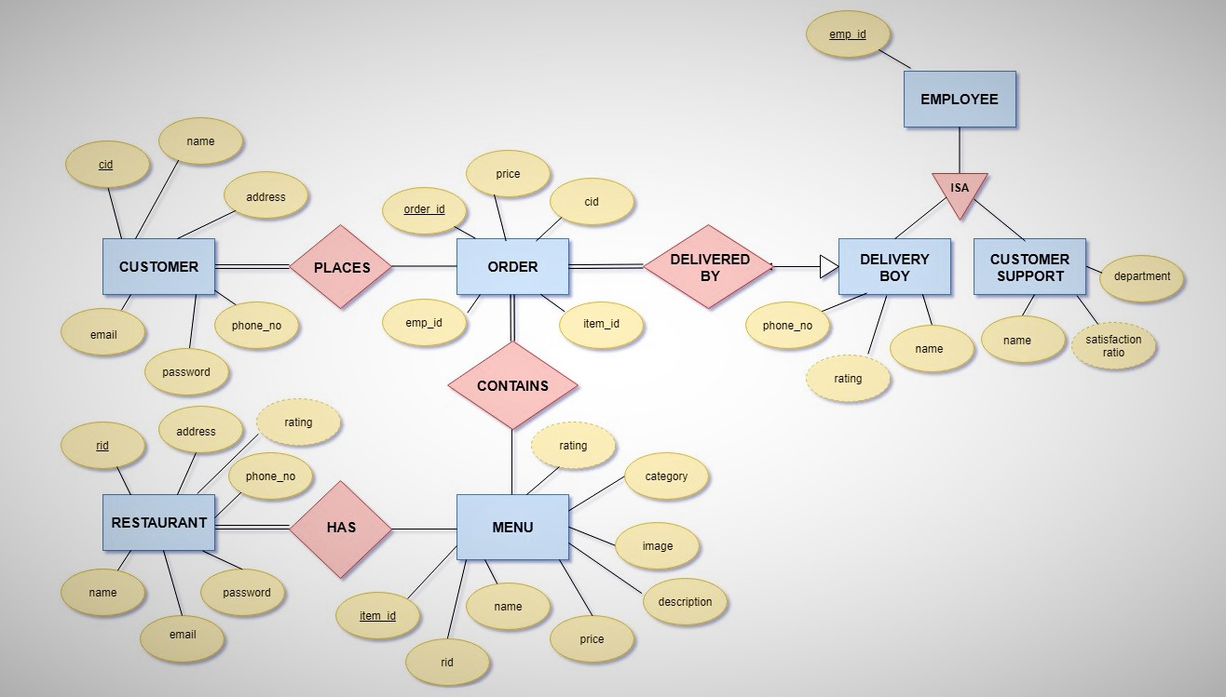
ER DIAGRAM

Slide 7
Entities and its Attributes
Customer [Attributes -> cid, name, email, password, phone_no, address]
Restaurant [Attributes -> rid, name, email, password, phone_no, address,rating]
Menu [Attributes -> item_id, name, rid, price, description, image, category, rating]
Order [Attributes -> order_id, emp_id, item_id, cid, price]
Employee[Attributes ->emp_id]
Delivery_boy [Attributes -> emp_id, name, phone_no, rating]
Customer_support [Attributes -> emp_id, name, department, satisfaction_ratio]

Slide 8
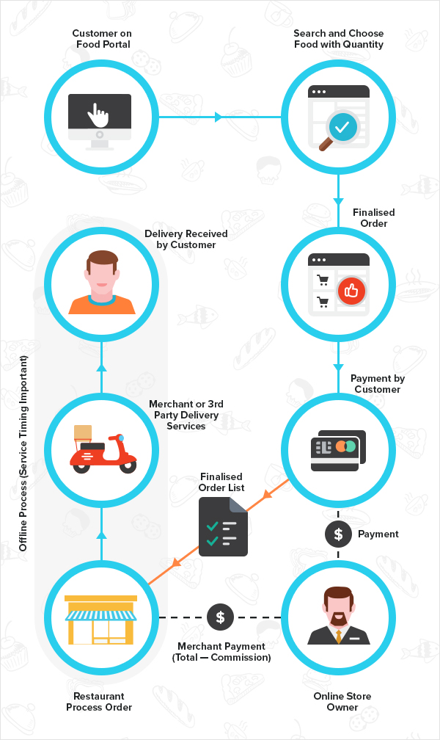
W
O
R
K
I
N
G

